Slide 1

Data Analyst Project
HDFC Bank Loan Report
Part 1
Ms SQL Server

Slide 2

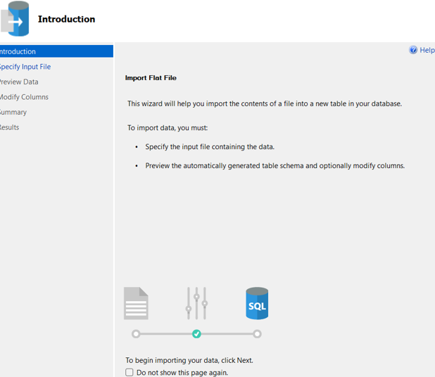

MS SQL Server
IMPORT
DATA

Slide 3
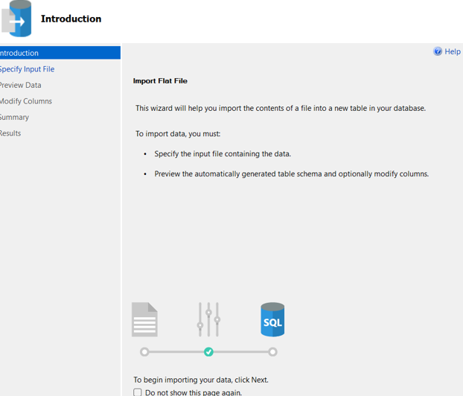

MS SQL Server
CREATING
DB

Slide 4
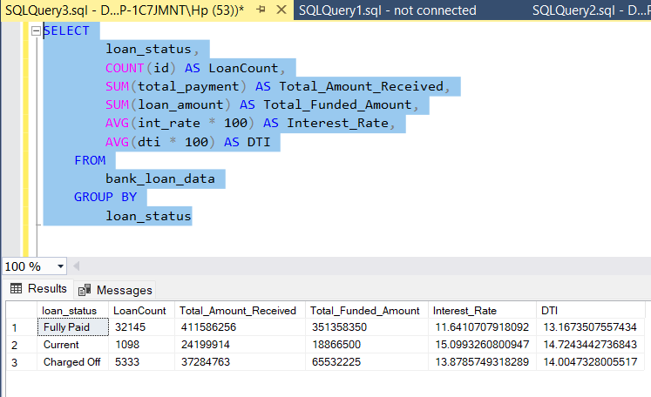
MS SQL Server
WRITING
QUERIES

Slide 5
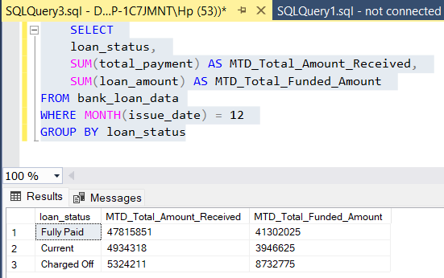
MS SQL Server
FIRING SQL QUERIES TO SOLVE THE BUSINESS PROBLEMS
COMPARING RESULTS WITH POWER BI, TABLEAU and EXCEL

Slide 6


DATA ANALYST BANK PROJECT
BANK LOAN ANALYSIS
PART 2
POWER BI

Slide 7



POWER BI
CONNECTING TO
MS SQL SERVER

Slide 8
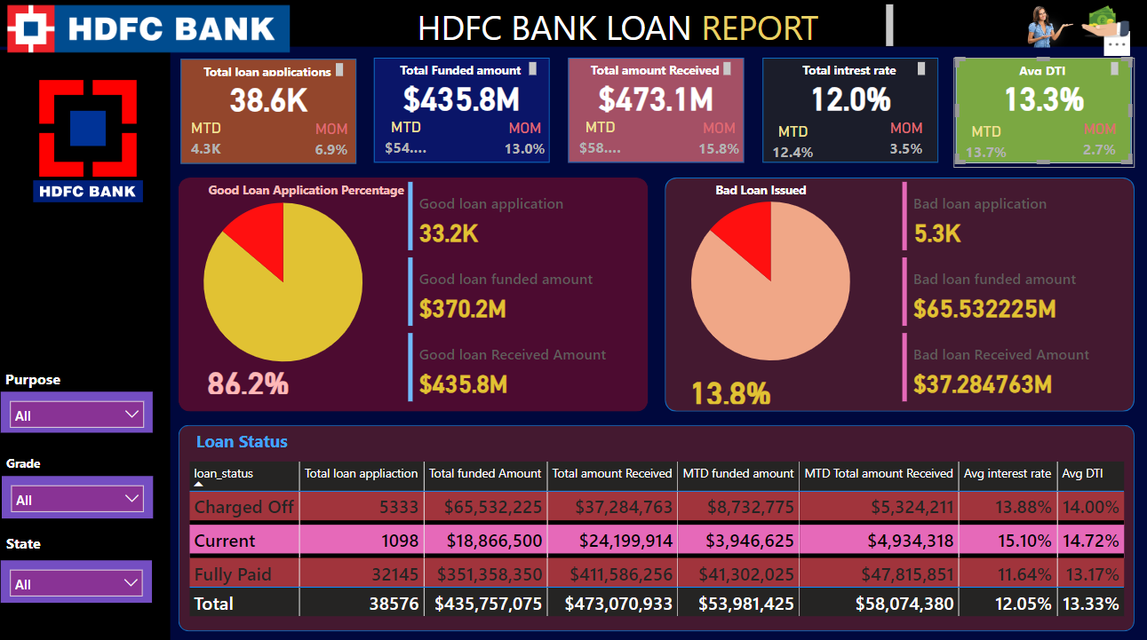
POWER BI

Slide 9

DASHBOARD 1: SUMMARY
PROBLEM STATEMENT
Key Performance Indicators (KPIs) Requirements:
Total Loan Applications: We need to calculate the total number of loan applications received during a specified period. Additionally, it is essential to monitor the Month-to-Date (MTD) Loan Applications and track changes Month-over-Month (MoM).
Total Funded Amount: Understanding the total amount of funds disbursed as loans is crucial. We also want to keep an eye on the MTD Total Funded Amount and analyse the Month-over-Month (MoM) changes in this metric.
Total Amount Received: Tracking the total amount received from borrowers is essential for assessing the bank's cash flow and loan repayment. We should analyse the Month-to-Date (MTD) Total Amount Received and observe the Month-over-Month (MoM) changes.
Average Interest Rate: Calculating the average interest rate across all loans, MTD, and monitoring the Month-over-Month (MoM) variations in interest rates will provide insights into our lending portfolio's overall cost.
Average Debt-to-Income Ratio (DTI): Evaluating the average DTI for our borrowers helps us gauge their financial health. We need to compute the average DTI for all loans, MTD, and track Month-over-Month (MoM) fluctuations.

Slide 10
PROBLEM STATEMENT
Good Loan v Bad Loan KPI’s
Good Loan:
Good Loan Application Percentage
Good Loan Applications
Good Loan Funded Amount
Good Loan Total Received Amount
Bad Loan
Bad Loan Application Percentage
Bad Loan Applications
Bad Loan Funded Amount
Bad Loan Total Received Amount
Loan Status Grid View
In order to gain a comprehensive overview of our lending operations and monitor the performance of loans, we aim to create a grid view report categorized by 'Loan Status.’ By providing insights into metrics such as 'Total Loan Applications,' 'Total Funded Amount,' 'Total Amount Received,' 'Month-to-Date (MTD) Funded Amount,' 'MTD Amount Received,' 'Average Interest Rate,' and 'Average Debt-to-Income Ratio (DTI),' this grid view will empower us to make data-driven decisions and assess the health of our loan portfolio.

Slide 11
SOFTWARE USED
MS OFFICE/ EXCEL: VERSION 2021
MS SQL SERVER: 19.0
SQL SERVER MANAGEMENT STUDIO – 19.0.20209.0
POWER BI: JUNE 2023 Version

Slide 12
THANKTOU

